Slide 1
Last Days of Life Template
End of Life Partnership and East Cheshire Hospice

Slide 2
1. Helps to support person-centred end of life care by:-
Patient
Ensures all elements of end-of-life care are addressed
Ensures recognition of dying and documentation
Facilitates clear and timely documented decision making
Provides a consistent approach across all services
Supports communication and documentation of advanced care planning to all HCPs involved in the holistic delivery of care
Supports co-ordination of care

Slide 3
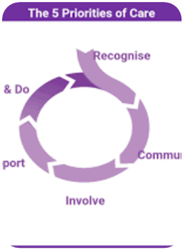
2. Developed and informed by national guidance and recommendations e.g., NICE Care of the Dying Adult, Five Priorities for Care of the Dying Person
NICE 2017 - People approaching the end of life receive consistent care that is coordinated effectively across all relevant settings and services, at any time of day or night.
EOLC is to be delivered by practitioners who are aware of the person's current medical condition, care plan and preferences by following local policies and procedures for information sharing
Five Priorities of Care for the dying person 2014
Key points:-
The Liverpool Care Pathway has been replaced by five priorities for care for dying people
1. Recognition of dying
2. Communicating with the patient sensitively and those who are important to them
3. Involving them and those important to them in the decision making in relation to their care.
4. Provision of multidisciplinary support
5. Creating an individualised plan of care and delivering it with compassion.

Slide 4
3. Supports defensible medico-legal documentation around last days of life decision making as highlighted by; Gosport Enquiry, Frances Review, More Care, Less Pathway (Liverpool Care Pathway)
More Care Less Pathway - Recommendations
NHS England to make improvements in the quality of care for the dying
Gosport Inquiry - Recommendations
Insufficient local prescribing guidelines in place, and lack of review.
NHS England to work with clinical commissioning groups to address the inconsistencies in the quality of care for the dying and drives improvement with better practices
The CQC to incorporate End of Life Care in the inspection program
Increased support for prescribing practice through supervision and appraisal
Lack of total patient assessment through MDT to determine care needs.
Frances report - Recommendations
NHS staff, including doctors and nurses, should have a legal ‘duty of candour’ – so they are obliged to be honest, open and truthful in all their dealings with patients and the public – CQC to include in a regulatory approach.
A clear line of leadership needs to be established, so it is always clear who is ultimately ‘in charge’ when it comes to a particular patient
Development of an open and honest organisation and promotion and safe facilitation of ‘freedom to speak up’ practices.
We only have ‘One Chance to Get it Right’

Slide 5
4. Time saving - reducing the need for End-of-Life paperwork e.g., Nurse Verification of Death Forms* and avoiding duplication as existing EPaCCS coding is pulled through. *Community patients only i.e., Care Homes may still require a paper form
5 Points only need to be included in your patients notes that use existing codes in multiple different templates inc EPaCCS
Prognosis
Blue booklet meds prescribed
Not for attempted CPR
Clinical assessment of patient's deterioration
Suitable for NVOD
It doesn’t matter where you have these coded within your documented templates, it will still pull through to the Last Days of Life template and Summary Screen.

Slide 6
5. Provides supportive evidence for CQC On inspection the CQC will require evidence that people with advanced, progressive, incurable illness are supported to live as well as possible until they die, and that the supportive and palliative care needs of both patient and family to be identified and met throughout the last phase of life and into bereavement.
Can you provided evidence if the CQC ask these questions?
Q) How do staff ensure that if people have increased needs this is identified and responded to? (e.g. need for change to medication, especially if on syringe driver or if they need one)
Q) Does the service use an Electronic Palliative Care Coordination System? If not, how is EOLC coordinated across areas, and with external providers and services?
Q) Do people have personalised care plans and how do they ensure that care is delivered in line with these?
Q) Are people told when they need to seek further help and advised what to do if their condition deteriorates? set out by the Leadership Alliance for the Care of Dying People?
Q) How is technology and equipment used to enhance the delivery of effective care and treatment and to support people’s independence?
Q) How does your service support and develop an approach that identifies patients where there is uncertainty about whether they may be approaching the end of life and are all patients approaching EOL identified in a timely way with appropriate action taken

Slide 7
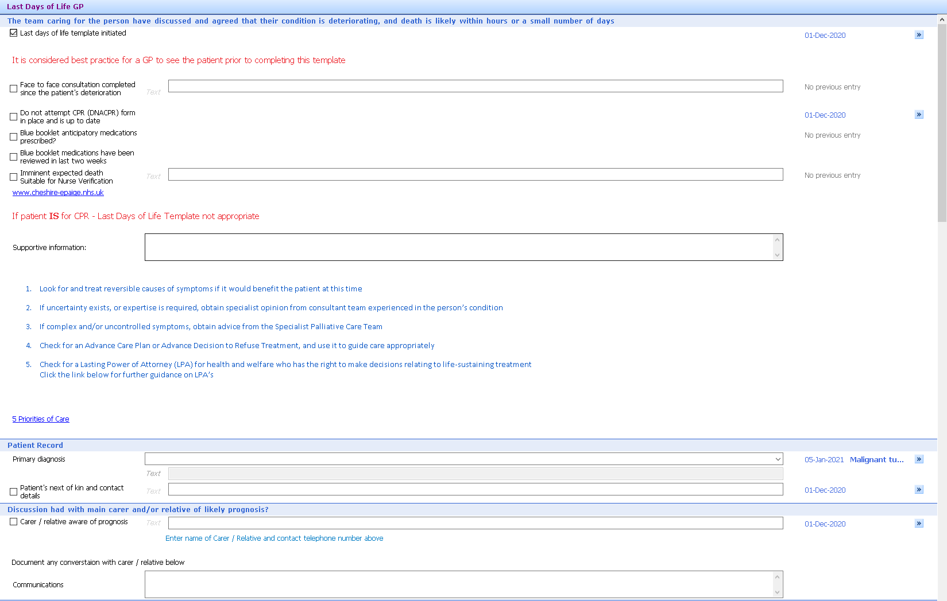
This image shows the first section of the Last Days of Life Template for GPs This template is a local template and will not be found in the EMIS library If your surgery / organisation has imported it you can search to find and use it. If you do not have the local template in your EMIS system please contact Mike Drew ICT Manager, East Cheshire Hospice→ mdrew@echospice.org.uk
Last Days of Life Template

Slide 8
Summary Screen Applications
If you are within the District Nursing team, the summary view has already been configured by your EMIS team for you to use.
GP Practices will need to configure this summary screen

Slide 9
6. Informs a 'quick glance' summary view across services where there are sharing agreements in place, to update on areas such as symptom control, communication with family, hydration, preferred place of death, suitability for Nurse Verification of expected death
Once the summary screen can be created and integrated into your organisations Emis accounts and then it can be added easily to your personal summary screen :-
For more information for creating the summary screen please access the How-to-Guide-for-Creating-Summary-Page-for-Last-Days-of-Life-1.pdf (cheshire-epaige.nhs.uk)

Slide 10
This animation shows how to add the Last Days of Life Summary tab to your Emis Ribbon Once it is added it will stay there and can be used for any patient unless deleted.

Slide 12
Additional Resources
For further help and support on ‘how to obtain the template’ or to ask general advice there are additional resources that can be accessed:-
End of Life Partnership - http://eolp.co.uk/ - link available to Cheshire e-Paige or email info@eolp.org.uk
Cheshire EPAIGE- http://www.cheshire-epaige.nhs.uk/ → Care in the Last Days of Life →NEW last Days of Life
Template information or GP quality improvement resources → http://www.cheshire-epaige.nhs.uk/document-library/?top-category=gp-contract-quality-improvement-projects-2019-20

Slide 13
Local Support Links
East Cheshire
East Cheshire Hospice – Mike Drew, IT Manager → mdrew@echospice.org.uk or Sarah Dale, Director of Quality and Innovation →sdale@echospice.org.uk
Specialist Palliative Care Team:- Macmillan Specialist Palliative Care Team, Mon-Fri 9am-5pm
Hope House, MDGH, Tel: 01625 663177 Bleep: 1004
South Cheshire and Vale
St Luke's Hospice – Tel: 01606 551246 - Kathryn Bailey Clinical Data Quality Manager kathryn.bailey@slhospice.co.uk
General Practitioners can also contact the local Macmillan Specialist Palliative Care team

