Slide 1
Advance Care Planning Hoping for the Best but Planning for the Worst.
COVID-19: Care Homes, Community Staff and GP’s
Cheshire CCG

Slide 2
Advanced Care Planning and COVID-19
Dr John McKay Frailty GP East Cheshire NHS Trust

Slide 3
What is Advance Care Planning?
It is an honest conversation about ‘goals of care’.
It will include decisions about DNACPR but it is broader than this, and needs to anticipate how the future care of each individual resident is managed should they become unwell.
In the current Coronavirus crisis it is important that a plan is in place for ALL care home residents.

Slide 4
Think About It
Plan and decide which staff will do this?
What support will they need?
Plan how you will work with each other – GP practices, care home staff and Community Staff
Which patients do we need to prioritise?

Slide 5
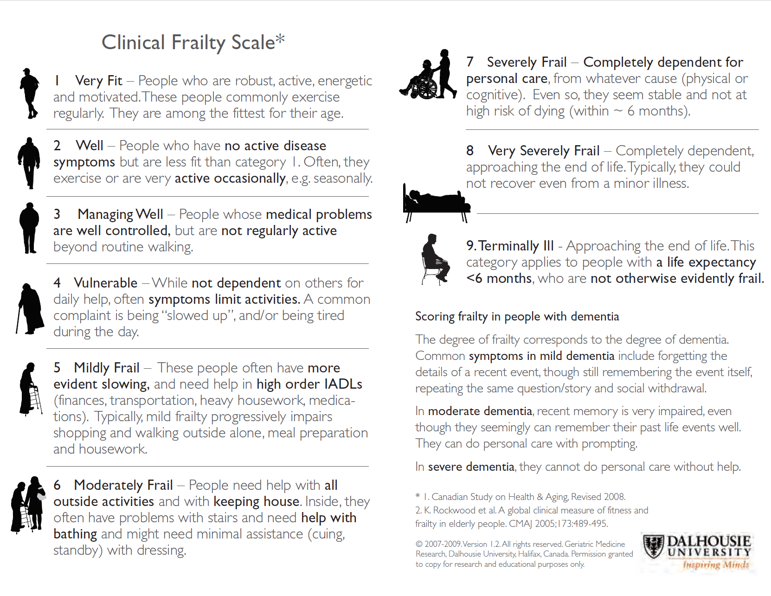

Slide 6
Talk About It
Support the resident to be involved and check they have capacity
Can they understand the need to make a decision about their future care?
Can they retain information long enough to make a decision?
Can they weigh up the pros and cons of a decision?
Can they communicate their decision to you?
If a person lacks capacity ask the family or LPA what they think the person would have want for their future care
Its important that choices that are offered are realistic and based on medical need

Slide 7
Record it
Record what conversations have been had with patients and whether you have assessed that they have capacity or not .
Record conversations with families or LPA’s.
Make sure there is a clear clinical plan that is specific to the potential needs of the residents: For example:
A) care or treatments to be considered (e.g. antibiotics for a chest infection)
B) care or treatments that are not recommended (e.g. not for invasive ventilation).

Slide 8
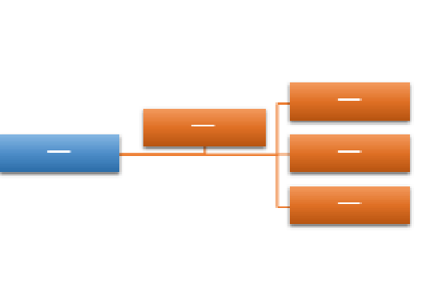
Share it
Check that residents, families and LPA’s understand what the Advance Care Plan is.
Make sure plans accessible and are kept alongside DNACPR forms in patients notes
When possible medical staff should code appropriately and share using EPaCC’s
Remember these plans can change as circumstances change and need to be reviewed.

Slide 9
Where can I get support with this?
Contact EoLP 01270 310 260 if you would like support in how to initiate these discussions and document them
Use the resources available on EPAIGE: http://www.cheshire-epaige.nhs.uk/

