Slide 1
Preferred Priorities for Care (PPC)

Slide 2
Preferred Priorities for Care (PPC)
Formerly known as Preferred Place of Care
Lancashire and South Cumbria Cancer Network.
Originally patient-held form for people living in the community with a cancer diagnosis
Focus on where people wanted to be cared for at the end of their lives.
Now Preferred Priorities for Care.
Focus on wider priorities than place of care
Preferences, values and wishes also important
Supported by NHS End of Life Care programme as an example of an advance care plan.

Slide 3

Potential triggers for PPC
Personal choice
Following life changing event
Following diagnosis of a life limiting illness
During assessment of a persons need
Following a significant shift in treatment
In conjunction with prognostic indicators
Multiple hospital admissions
Admission to a care home

Slide 4
It should be...
Entirely voluntary not forced
A continuous process and not ‘task and finish’
Person led not professional led
Aim to manage expectations not raise them
Inclusive of the family where appropriate
Communicated to others with permission (NWAS, OOH, GP)
Reviewed and updated regularly as dictated by the client or as the result of a significant event i.e. Hospital admission
Kept in a visible & accessible place

Slide 5

Starting PPC Conversations
P – Prepare for discussion/ environment/time
R – Relate to the person/ Am I the right person?
E – Elicit client preferences, beliefs/ cues
P – Provide information/ informed decisions
A – Acknowledge emotions and concerns
R – Realistic hope/ manage expectations
E – Encourage questions/ allow reflection
D – Document

Slide 6
What to talk about?
Person’s agenda;
What are the persons feelings about their illness, what concerns do they have, what goals are they looking to reach, do they understand their illness and its prognosis, do they have particular care preferences, now and in the future?
Tools that may help trigger conversations;
    Thinking about it! Prompt card
    Notice board
    Conversations for life cards
    Dying Matters Resources/ Events
    Reminiscence groups/ memory boxes

Slide 7

Who completes the documentation?
Patient held document
Ideally patient
Could be a relative with patients input
Could be professional with patient
Potentially an individual with LPA for health & welfare could fill in for a patient.

Slide 8
Recording preferences
The explicit recording of patients/carers wishes can form the basis of care planning in multi-disciplinary teams and other services, minimising inappropriate admissions and interventions.
In relation to your health what has been happening to you?
What are your preferences and priorities for your future care?
Where would you like to be cared for in the future?

Slide 9
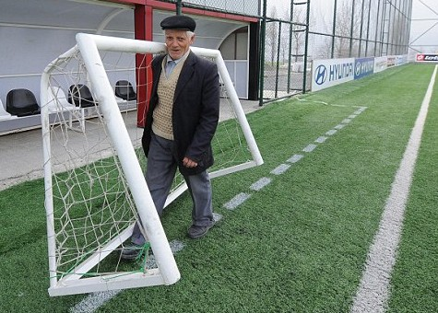
Challenges of using PPC
Challenging and sometimes complex conversations
No hiding from the ‘End of Life’ conversation
Family conflict and coercion
Potential for increased burden on the family
Managing expectations
Goal posts will often move

Slide 10
Supporting Resources: Poster
Illustrates a uniform approach underpinning the culture of the organisation
Individuals are less threatened and suspicious of rationale
Delivers a consistent message
Triggers conversations

Slide 11
Supporting Resources: Leaflet
Illustrates a collaborative approach with national initiatives
Allows personal space for consideration
Delivers a consistent message
Supports conversations

Slide 12
Supporting Resources: Factsheet
Provides guidance for people using the PPC
Additional information for clients and family

Slide 13
Supporting Resources: Easy Read
Version for use with clients who have communication difficulties i.e. Learning disabilities, dementia

Slide 14

Any Questions?
Contact your Macmillan Team or the End of Life Care Team
Bespoke training is available on request
Thank you for taking the time to view this presentation

