Slide 1
COVID-19 DEMENTIA CARE Resources With A Focus On Families And Informal Carers
brought together by the Advanced Dementia Support Team: EoLP

Slide 2
Teepa Snow: Positive Approach to Care
Are you familiar with Teepa Snow’s work?
Teepa is using youtube as a repository for a wealth of advice and support for caring day to day during this COVID-19 outbreak
Here is a link to one example of her advice
Click Here

Slide 3
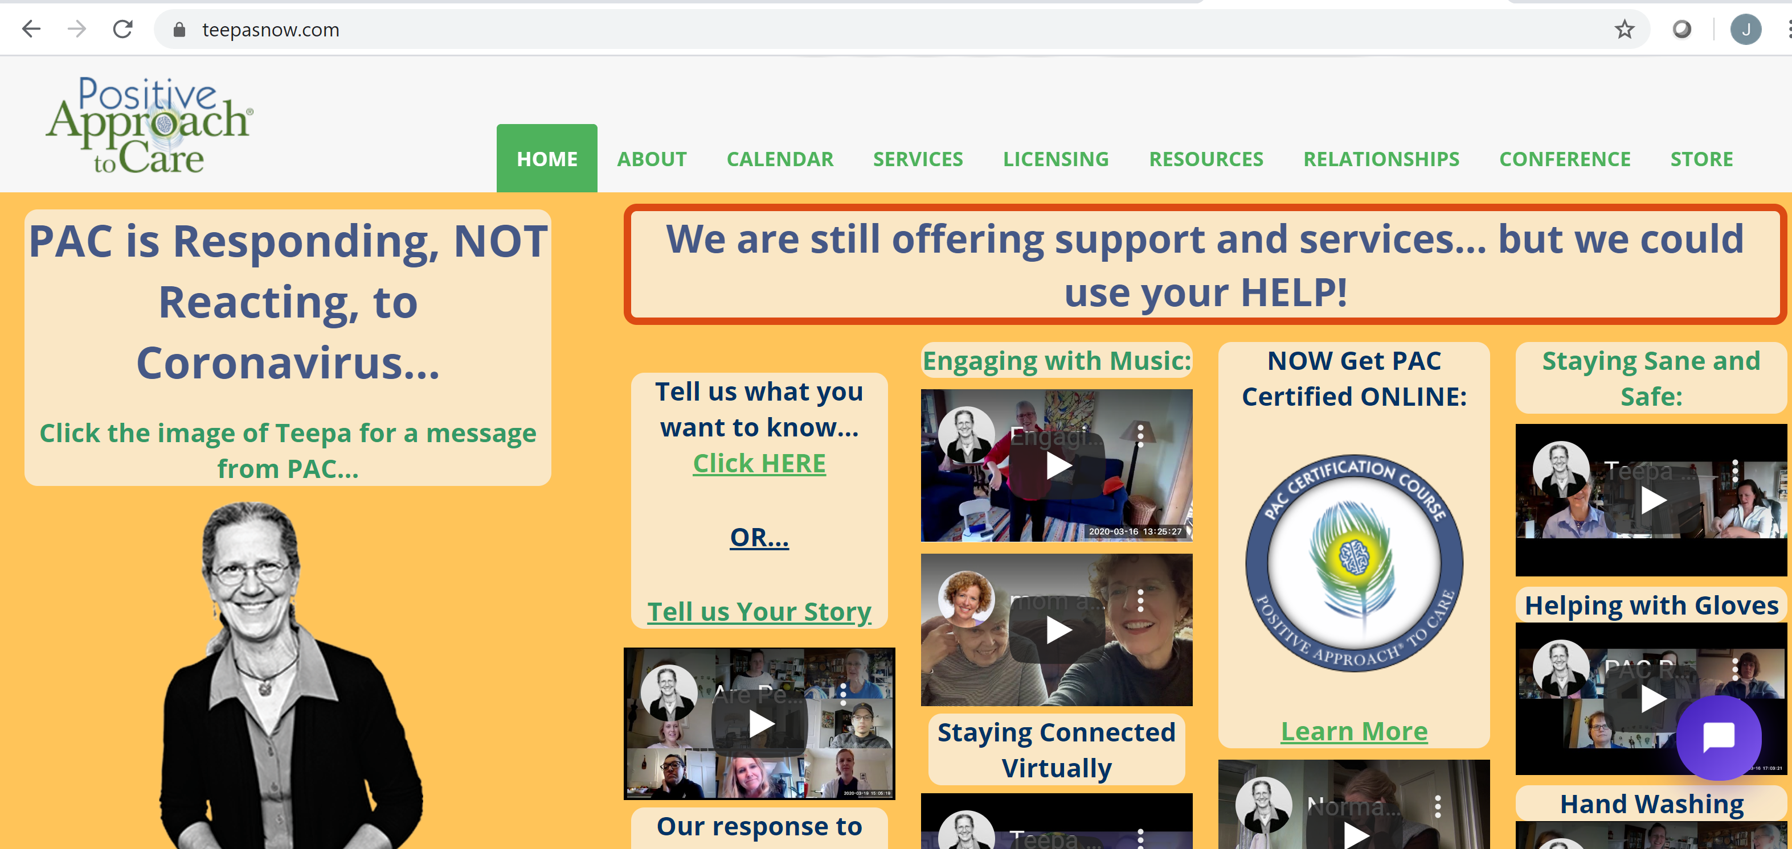
More advice and support on Teepa’s website

